Slide 1

Decoding the Skies
Insights from SpaceX Rocket Data Science

Slide 2

Outline
Executive Summary
Introduction
Methodology
Results
Conclusion
Appendix

Slide 3
Executive Summary
The following methodologies were used to analyze the data
Data collection using Web scraping and SpaceX API
Exploratory data analysis using Data Visualization, Data Wrangling, interactive Visual analytics.
Various Machine Learning Algorithms
This data science study examines the landing of rockets by SpaceX, focusing on the analysis of key factors that contribute to successful landings. By leveraging extensive data collected from numerous SpaceX rocket launches, This study aims to provide valuable insights into the challenges, trends, and improvements associated with rocket landings.

Slide 4
Introduction
The main objective of this study is to ﬁnd the trends and factors which affect landings of rockets.
Question: How can we use the previous data to predict if a rocket and land Safely?
Desired Answers:
The best way to estimate the total cost for launches, by predicting successful landing of the ﬁrst stage of rockets
Where is the best place to land and launch ?

Slide 5
Methodology

Slide 6
Methodology
Data collection Methodology:
Data from Space C was obtained from 2 sources: Space C APi- https://api.spacexdata.com/v4/rockets/ Web Scraping-
https://en.wikipedia.org/wiki/List_of_Falcon/_9/_and_Falcon_Heavy_launches
Perform Data Wrangling
Collected Data was enriched by creating a landing outcome label based on outcome data after summarizing and analyzing features
Notebooks:
https://github.com/Gyaneshwar-Seemala/Data-Science-Capstone/blob/master/Data-Collection-API.ipynb https://github.com/Gyaneshwar-Seemala/Data-Science-Capstone/blob/master/Data-Collection-With-Web-Scrapping.ipynb https://github.com/Gyaneshwar-Seemala/Data-Science-Capstone/blob/master/Data-Wrangling.ipynb

Slide 7
Methodology
Perform exploratory data analysis using Visualization and SQL
Perform interactive visual analytics using Folium and Plotly Dash
Perform predictive analysis using classiﬁcation models
Data that was collected until this step were normalized, divide into training and test data sets and evaluated by four different classiﬁcation models, being the accuracy of each model evaluated using different combinations of parameters
Notebooks:
https://github.com/Gyaneshwar-Seemala/Data-Science-Capstone/blob/master/EDA.ipynb https://github.com/Gyaneshwar-Seemala/Data-Science-Capstone/blob/master/EDA-With-SQL.ipynb https://github.com/Gyaneshwar-Seemala/Data-Science-Capstone/blob/master/DashBoard.ipynb

Slide 8
Predictive Analysis
One of the primary goals of predictive analysis is to uncover hidden insights and make informed decisions based on the predicted outcomes. It can be applied across various industries and sectors, such as ﬁnance, healthcare, marketing, manufacturing, and more, to optimize operations, improve customer experiences, mitigate risks, and drive strategic planning.
Created a interactive dashboard using Dash.
https://github.com/Gyaneshwar-Seemala/Data-Science-Capstone/blob/master/Predictive-Analysis.ipynb https://github.com/Gyaneshwar-Seemala/Data-Science-Capstone/blob/master/spacex_dash_app.py

Slide 9
Results
Exploratory data analysis results
Space X uses 4 different launch sites
The ﬁrst launched were done to space X itself and NASA
The average payload of F9 v1.1 booster is 2928 kg
The ﬁrst success landing outcome happened in 2015 ﬁve years after the ﬁrst launch
Many falcon 9 booster versions were successful at landing in drone ships having payload above the average
Almost 100% of mission outcomes were successful
Two booster versions failed at landing in frone ships in 2015: F9 v1.1 B1012 and F9 v1.1 B1015
The number of landing outcomes became as better as years passed

Slide 10

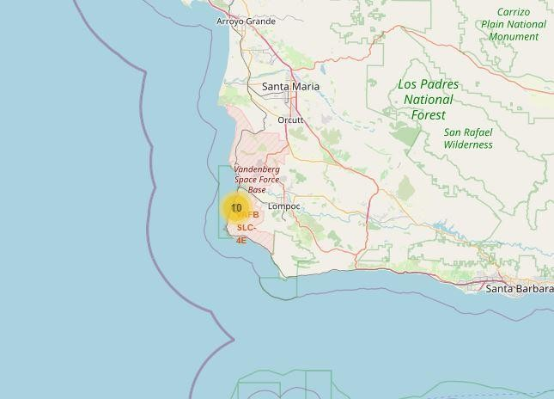

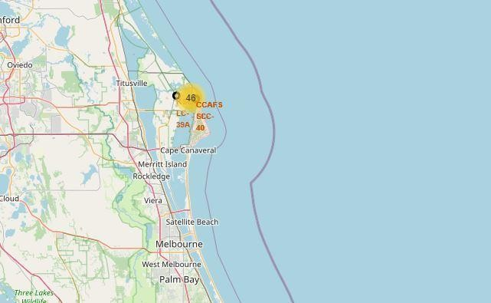
Results
Using interactive analytics was possible to identify that launch sites use to be in safety places, near sea, for example and have a good logistic infrastructure around.
Most launches happens at east coast launch sites

Slide 11
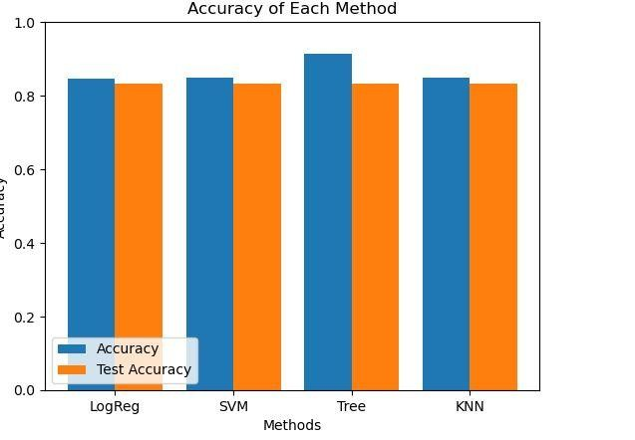
Results
Predictive analysis showed that Decision Tree Classiﬁer is the best model to predict successful landings, having accuray overy 83% and accuracy for test data over 91%

